Slide 1
GUI Programming in python
Unit 1- part 2

Slide 2
Checkbutton widget
The Checkbutton widget is used to display a number of options to a user as toggle buttons. The user can then select one or more options by clicking the button corresponding to each option.
Syntax
w = Checkbutton ( master, option, ... )
Parameters:
master: This represents the parent window.
options: Here is the list of most commonly used options for this widget. These options can be used as key value pairs separated by commas.

Slide 3
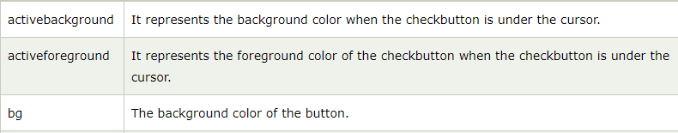
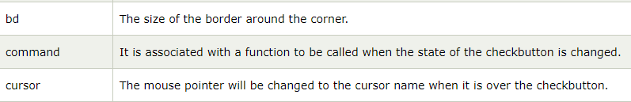
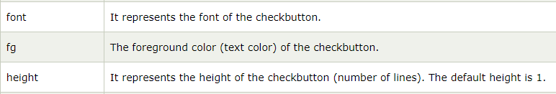
Options

Slide 4
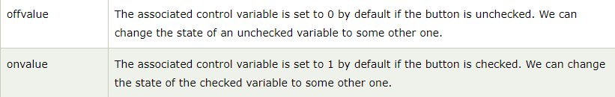
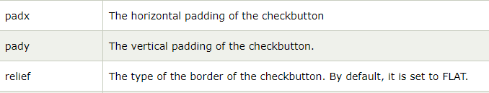
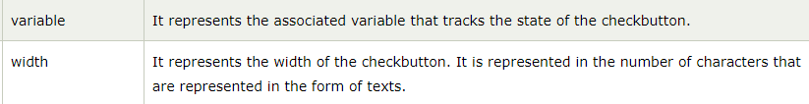

Slide 5
Radiobutton widget
This widget implements a multiple-choice button, which is a way to offer many possible selections to the user and lets user choose only one of them.
In order to implement this functionality, each group of radiobuttons must be associated to the same variable and each one of the buttons must symbolize a single value. You can use the Tab key to switch from one radionbutton to another.
Syntax
w = Radiobutton ( master, option, ... )
Parameters
master: This represents the parent window.
options: Here is the list of most commonly used options for this widget. These options can be used as key-value pairs separated by commas.

Slide 6

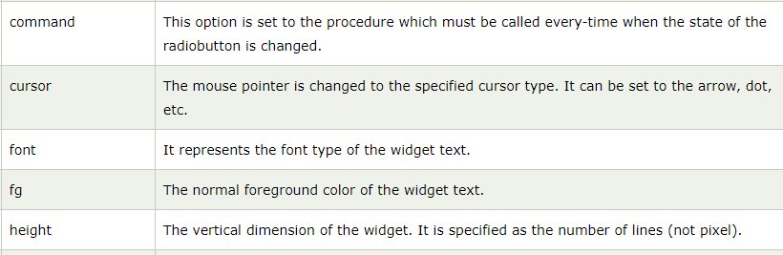
Options

Slide 7
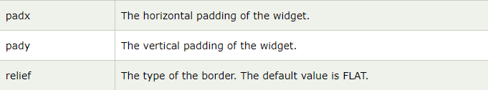
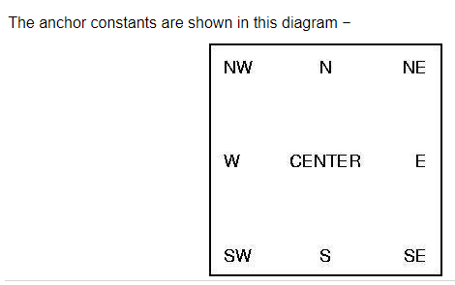

Slide 8
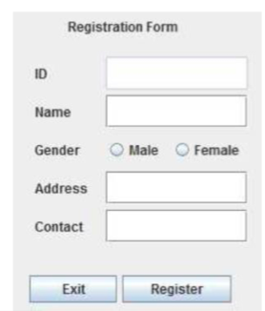
example

Slide 9
Listbox widget
The Listbox widget is used to display a list of items from which a user can select a number of items
Syntax
Here is the simple syntax to create this widget −
w = Listbox ( master, option, ... )
Parameters
master: This represents the parent window.
options: Here is the list of most commonly used options for this widget. These options can be used as key-value pairs separated by commas.

Slide 10
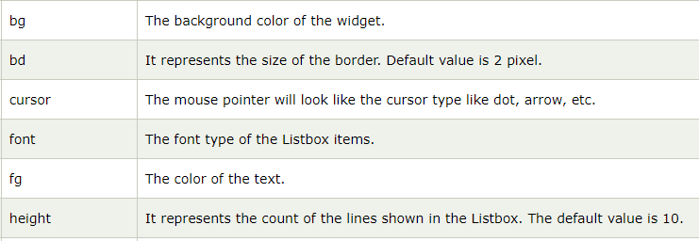
Options
Methods

Slide 11
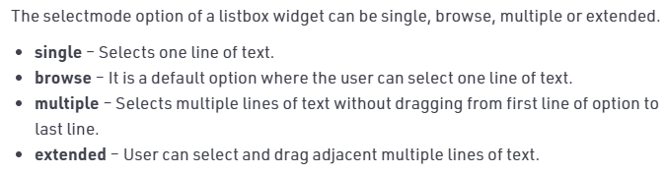

Slide 12
Spinbox widget
The Spinbox widget is an alternative to the Entry widget. It provides the range of values to the user, out of which, the user can select the one.
It is used in the case where a user is given some fixed number of values to choose from.
We can use various options with the Spinbox to decorate the widget. The syntax to use the Spinbox is given below.
w = Spinbox(master, options)
master − This represents the parent window.
options − Here is the list of most commonly used options for this widget. These options can be used as key-value pairs separated by commas.

Slide 13
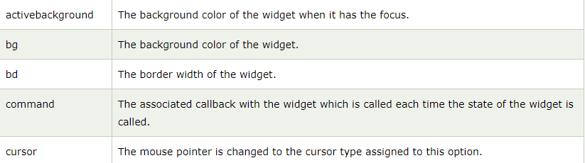

Options:

Slide 14
Increment- used to increase the content of spinbox by the specified value
Methods:

Slide 15
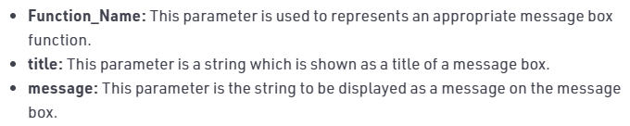
Messagebox widget
The messagebox module is used to display the message boxes in the python applications. There are the various functions which are used to display the relevant messages depending upon the application requirements.
Syntax:-
messagebox.function_name(title, message)

Slide 16
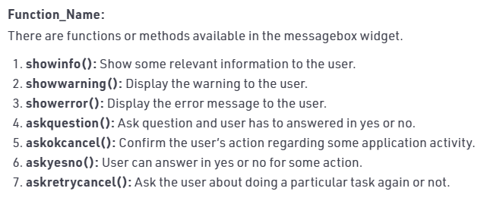

Slide 17
Combobox widget
Combobox is a combination of Listbox and an entry field. It is one of the Tkinter widgets where it contains a down arrow to select from a list of options.
It helps the users to select according to the list of options displayed. When the user clicks on the drop-down arrow on the entry field, a pop up of the scrolled Listbox is displayed down the entry field.
The selected option will be displayed in the entry field only when an option from the Listbox is selected.
Syntax:

Slide 18
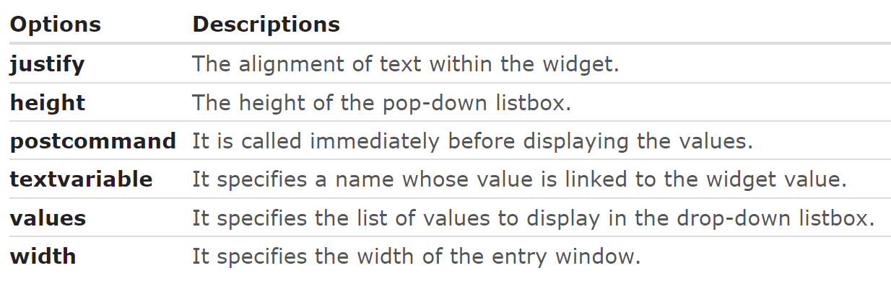
To get the currently selected value, you can use the variable defined in combobox using get method.
Alternatively, you can use the get() method of the combobox object

Slide 19
drawing on canvas
The Canvas is a rectangular area intended for drawing pictures or other complex layouts. You can place graphics, text, widgets or frames on a Canvas.
Syntax
w = Canvas ( master, option=value, ... )
master − This represents the parent window.
options − Here is the list of most commonly used options for this widget. These options can be used as key-value pairs separated by commas.

Slide 20
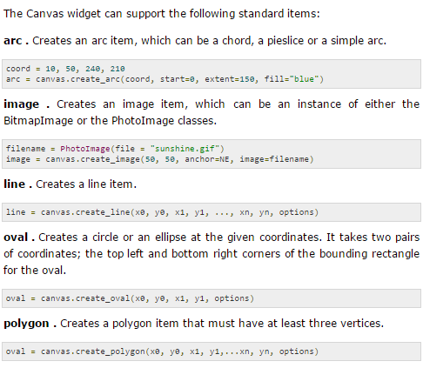

Slide 21
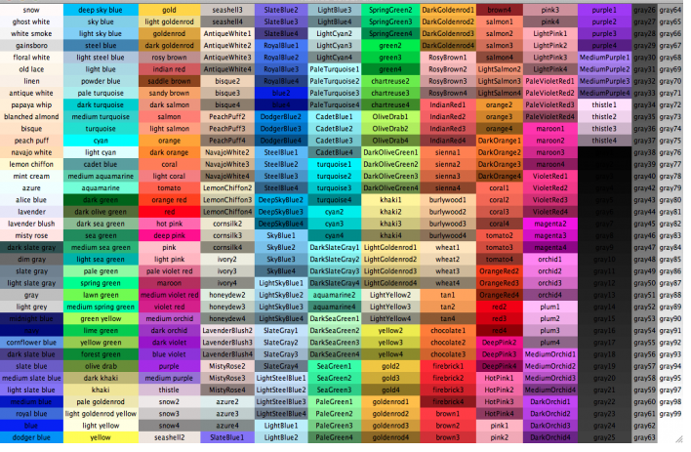
color

Slide 22
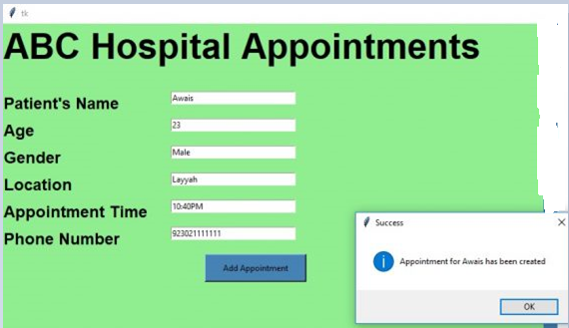

Slide 23
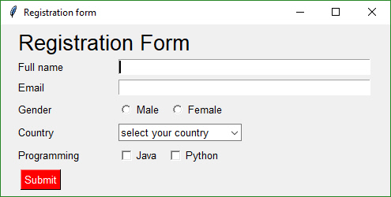

Slide 24
